Slide 1
Coarse-Grained Reconfigurable Devices (CGRA)

Slide 2
CGRA - Introduction
CGRA:
Array of operation units + memories + routing resources
Functional units:
Customized for specific application/domain
Acceleration of Convolutional neural networks (application), machine learning (domain)

Slide 3
CGRA - Introduction
Closer look
[Karunaratne17]

Slide 4
CGRA - Introduction
CGRA vs. FPGA:
FPGA:
Boolean-level blocks
Mainly bit-width operations (LUT/MUX)
CGRA:
Computational blocks
Word-width operations

Slide 5
CGRA - Introduction
Advantages:
Better performance per power (for computation-centric applications)
More efficient area usage for interconnections
In FPGAs: major portion of config. info.: for routing resources
In CGRA: interconnections bundled to words with fewer config. bits.
Less CAD complexity
Due to reduced number of decisions
Easier dynamic reconfiguration (fast context switching)
Disadvantages:
Less general purpose
CGRAs are mostly research prototypes

Slide 6
CGRA as Accelerator/Coprocessor
Two types:
Stand-alone
Should be able to execute the entire application
Mainly as accelerator to processors:
Computation-intensive part → CGRA
CGRA components: similar to components of processors
Host:
RISC
VLIW: Advantage: speed up the software part of application (Amdahl’s law)

Slide 7
Hardware Platforms for Coarse-Grained Applications
[Liu19]

Slide 8
Hardware Platforms for Coarse-Grained Applications
[Liu19]

Slide 9
Applications
Security
Reconfigurable cryptographic processors for multiple algorithms
COBRA (for > 40 symmetric ciphers)
Celator (for block ciphers (AES/DES) and hash functions (SHA))
Cryptoraptor (for symmetric key cryptography)

Slide 10
Applications
Signal and image processing
Advanced video coding (H.264/AVC) or MPEG4
Image processing
Networks: Software defined radio, MIMO detection

Slide 11
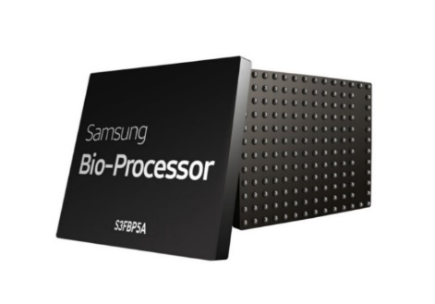
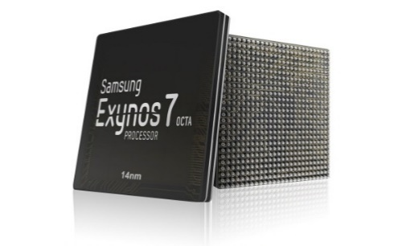
Applications
Deep learning
Eyeriss (MIT):
Convolutional neural networks (CNN) operations in systolic manner
Reconfigurable hybrid-neural network processor for deep learning application
Biomedical Engineering
Samsung SRP: Mobile healthcare
Mobile Computing:
In Samsung Exynos processor

Slide 12
ADRES

Slide 13
ADRES
ADRES (Architecture for Dynamically Reconfigurable Embedded System) [Mei03]
Couples VLIW and CGRA (2 modes of operation)
Resource sharing (FUs and RFs)
FU: Functional Unit
RF: Register File
RC: Reconfigurable Cell

Slide 14
ADRES
FUs:
Execute word-level operations (selected by a control signal)
RFs:
Store intermediate data
Resource sharing for two views:
Don’t execute simultaneously
Communications between two parts:
Through shared RFs

Slide 15
ADRES
Purpose of reconfigurable matrix:
Accelerate dataflow-like operations in parallel
Reconfigurable Cell (RC):
Configuration RAM:
Can store a few configurations
Loaded at each cycle to SRAM cells
Reconfigured at each cycle in CGRA mode
Like instruction execution:
Configuration determines the behavior of cell by selecting operations and muxes

Slide 16
ADRES
Template architecture:
Detailed architecture: XML-based language:
Communication topology
Operation set
Timing of target architecture
Shared resources:
E.g., two FUs share one RF

Slide 17
Samsung ULP-SRP

Slide 18
Samsung SRP
ULP-SRP (Ultra Low Power - Samsung Reconfigurable Processor) [Kim14]:
For mobile healthcare device
Based on ADRES
VLIW mode
CGRA mode
Aims:
High performance (parallel FUs)
Low energy
CGRA mode:
Many FUs working in parallel
Increased power consumption but shortening the execution time
Positive effect of shorter run time > Negative effect of power consumption
→ better energy efficiency

Slide 19
Samsung SRP: Die Photo

Slide 20
SRP Architecture
VLIW mode:
For complex processing that cannot be scheduled on CGRA
CGRA LP mode:
Low performance
Sufficient for some biomed. applications
CGRA HP mode:
High performance
For more complex algorithms

Slide 21
Loop Scheduling
Software pipelining for loops:
Scheduling of loops
Considering DFG
Using 2 parallel FUs (FU0, FU1)
Data Flow Graph
T = 7
T = 8

Slide 22
Loop Scheduling
Software pipelining for loops:
Scheduling of loops
Loop pipelining
Data Flow Graph

Slide 23
SRP Mode Selection
Dynamic mode selection:
Some loops have high data parallelism
→ High Instruction Per Cycle (IPC)
→ Run in HP mode
Some loops don’t
→ low IPC
→ Run in LP mode → low energy
Compile application twice:
Performance simulator → execution cycle of each loop for two modes
→ Uses mode selection for each loop

Slide 24
SRP Mode Selection

Slide 25
SRP Mode Selection
ECG application
FFT application
high data parallelism and IPC of FFT
→ HP: energy-efficient for the entire loop

Slide 26
SRP Mode Selection
Duty cycle in ECG application
T_{process} / (T_{process} + T_{data collection})
HP mode → smaller(?) duty cycle

Slide 27
SRP Mode Selection
EMG application (ElectroMyoGram)
Collects electrical activity from muscles
Execution cycles of each loop mapped to CGRA (threshold: 1.7)

Slide 28
SRP Mode Selection
EMG application
Dynamic mode selection:
Combination of modes

Slide 29
Unified Memory Architecture
Reconfigurable memory
Some applications need more data (instruction) memory than others
A 3-channel ECG application needs 3× bigger data buffer than 1-channel ECG
Notes:
Data address (instruction address) is decoded and lets the data be written/read to the appropriate address in shared memory or data memory. E.g., shared memory is specified for data. Then when data address is decoded, the address causes the DEMUX to send the write data to either shared memory or data memory (depending on the address value). Or the decoded address causes the MUX to get the data from either the shared memory or data memory to Read Data. In fact the output of Address Decoding module should be connected to the top and bottom MUXes as well. And Inst. Address and Data Address (lower significant bits) should be connected to the memory blocks too.

Slide 30
HyCUBE

Slide 31
HyCUBE
CGRA with configurable interconnect architecture
→ Single-cycle communications between distant FUs
Most CGRAs: static links connecting neighbor to neighbor
→ Distant FUs: routed through intermediate FUs
→ Costs: Multiple cycles + Occupied FUs
Previous analysis (ADRES):
Optimal energy-efficiency can be achieved through addition of more interconnects

Slide 32
Conventional CGRA
Neighbor-to-neighbor:
If neighboring PEs are not available, dependent operations are mapped farther apart:
Must traverse farther
→ More cycles
→ HyCUBE:
communicates with distant PEs in a single cycle
+
X
-
MORE CYCLES
+
R
R
X
SINGLE CYCLE
-

Slide 33
HyCUBE Architecture
CONFIG
MEM
ALU
P
I 1
I 2
OP
XBAR
RES
Asynchronous Repeaters
CGRA with configurable interconnect architecture
Crossbar Switch:
6 inputs to 7 outputs
Multicasting
NORTH
R0
CrossBar Switch
NORTH
EAST
R1
EAST
WEST
R2
WEST
SOUTH
R3
SOUTH
D A T A M E M O R Y
0
1
2
3
X
X
X
X
4
5
6
7
X
X
X
X
8
9
10
11
X
X
X
X
12
13
14
15
X
X
X
X

Slide 34
Optimal Mapping (N2N CGRA)
DFG of an loop iteration
N1
N1
N1
N6
N1
CYC 0 / CYC 3
F0
F1
N5
F2
F3
N4
N5
N2
N3
N4
N3
N3
N3
R
R
CYC 1
F0
F1
N7
N6
N6
N2
F2
F3
N7
N4
N4
CYC 2
F0
F1
2x2 CGRA
R
R
N5
F2
N5
F0
F1
F3
CYC 3/ CYC 0
F0
F1
N6
F2
F3
N1
N6
F2
F3

Slide 35
Mapping Example (N2N CGRA)
Mapping example:
DFG
2x2 N2N CGRA architecture
Another view

Slide 36
HyCUBE
Optimal mapping on N2N:
-

Slide 37
Optimal Mapping (HyCUBE)
N1
N7
N1
N1
N1
CYC 0 / CYC 2
F0
F1
N6
F2
F3
N5
N2
N3
N4
N5
N3
N2
N7
N6
CYC 1
F0
F1
N4
N5
F2
N5
F3
Advantage:
Any FU can reach far-away FU (or multiple FUs): within a single cycle
N1
N7
CYC 0 / CYC 2
F0
F1
N6
F2
F3
Initiation Interval (II) = 2:
Number of cycles between the initiation of two consecutive loop iterations

Slide 38
HyCUBE
Optimal mapping on HuCUBE:
Any FU can reach far-away FU (or multiple FUs) within a single cycle
Initiation Interval (II):
Number of cycles between the initiation of two consecutive loop iterations

Slide 39
HyCUBE
Comparison with commercial devices

Slide 40
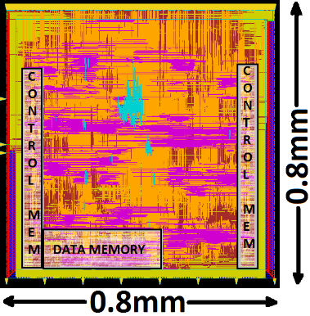
HyCUBE RTL Implementation
4x4 CGRA synthesized + P&R
Power estimates via RTL Simulation
Artix 7 FPGA: 10x faster than ARM
SRP: 2x better power efficiency than ARM but much slower
HyCUBE: 3x faster and 4x more power efficient than ARM
Technology | TSMC 28nm
Max. Freq | 704 MHz
Area | 0.64 mm²
Power | 115.60 mW
Performance and Power (Scaled to 28nm) for running 256-FFT
 | Perf(MIPS) | Power(mW) | MIPS/mW
ARM Cortex-A5 | 2229 | 143 | 16
Xilinx Artix7 | 22604 | 1410 | 17
Samsung RP | 467 | 21 | 32
HyCUBE | 6648 | 105 | 63
Notes:
As for the HyCUBE’s RTL implementation we used a 4x4 version on TSMC 28nm.
We evaluated HyCUBE against the other processing architectures suitable for embedded domain and it turns out HyCUBE brings the best power-efficiency.

Slide 41
Clustered Architecture

Slide 42
Clustered Architecture
Clustered architecture [Walker19]:
Groups of 4 PEs connected to crossbars connected in a grid
PEs within a cluster: fully-connected
Only one connection between clusters
Each cluster:
One memory port
One IO port

Slide 43
References
Motomura, Hariyama and Watanabe, “Advanced Devices and Architectures,” in Hideharu Amano, Principles and Structures of FPGAs, Springer, Singapore, 2018.
Mai, et al., “ADRES- An architecture with tightly coupled VLIW processor and coarse-grained reconfigurable matrix,” FPL, 2003.
Kim, et al., “ULP-SRP: Ultra Low-Power Samsung Reconfigurable Processor for Biomedical Applications,” ACM Transactions on Reconfigurable Technology and Systems, Vol. 7, No. 3, August 2014.
Karunaratne, et al., “HyCUBE: A CGRA with Reconfigurable Single-cycle Multi-hop Interconnect,” DAC 2017, USA.
Walker and Anderson, “Generic Connectivity-Based CGRA Mapping via Integer Linear Programming,” 2019

Slide 44
References
Liu, Leibo, Jianfeng Zhu, Zhaoshi Li, Yanan Lu, Yangdong Deng, Jie Han, Shouyi Yin, and Shaojun Wei. "A survey of coarse-grained reconfigurable architecture and design: Taxonomy, challenges, and applications." ACM Computing Surveys (CSUR) 52, no. 6 (2019): 1-39.
Podobas, Artur, Kentaro Sano, and Satoshi Matsuoka. "A survey on coarse-grained reconfigurable architectures from a performance perspective." IEEE Access 8 (2020): 146719-146743.

